Slide 1

CS 533 INTRO TO DATA SCIENCE
Michael Ekstrand

Slide 2
DESCRIBING DATA

Slide 3
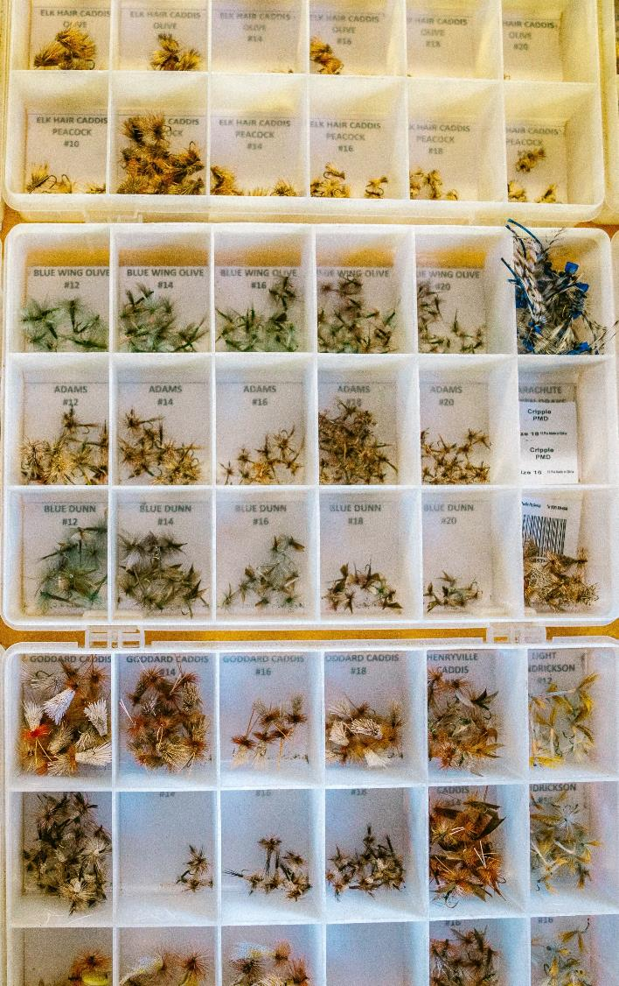
Learning Outcomes (Week)
To load a data file into Pandas and describe its basic structural characteristics.
To identify the type of a variable and descriptive statistics appropriate to it.
To describe the distribution of a variable numerically and visually.
To describe how data was collected.
To reason about limitations of the collection of data.
Photo by Michael Aleo on Unsplash

Slide 4
What is data?
Oxford:
data, n.: Facts and statistics collected together for reference or analysis.

Slide 5
Where does it come from? Where does it go?
Things
Phenomena / Experiment
“Raw” Data
Answers
Inferences
Data Set

Slide 6
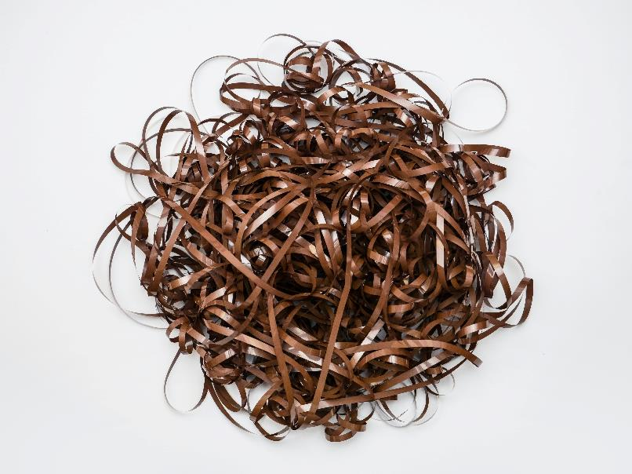
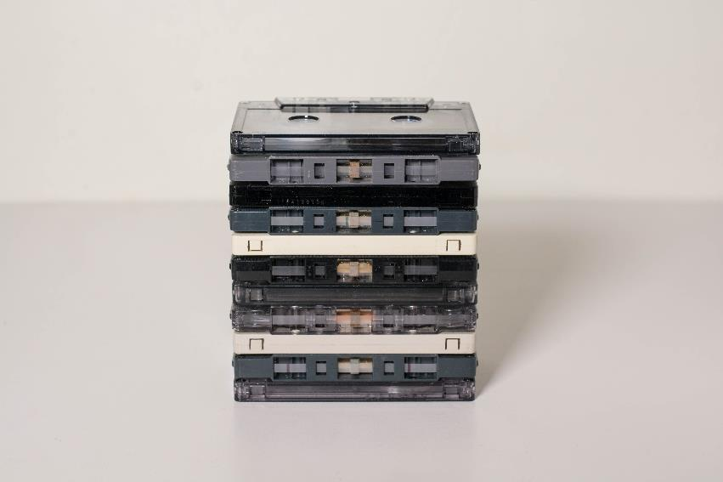
Cleaning Things Up
Data
Data set
Photo by Dan-Cristian Pădureț on Unsplash
Photo by Brian Kostiuk on Unsplash

Slide 7
Data sets
Many definitions, see the reading.
A set of data that is
Collected or curated
For a purpose
Mostly ready-to-use
Documented

Slide 8
Examples
Measure the ground speed of three-toed sloths
Data set: measured time for sloths moving 5 meters
May include other sloth attributes (height, weight, etc.)
Movie ratings
Thing: people enjoy movies
Phenomena: watch and rate movies
Data: user-provided ratings of movies

Slide 9
What We Need To Know
How much data do we have?
What kind(s) of data do we have?
What is the data about?
How was the data collected?
How was the data recorded?
What biases might the data have?
What do we know about the data generating process?
Reading discusses more!

Slide 10
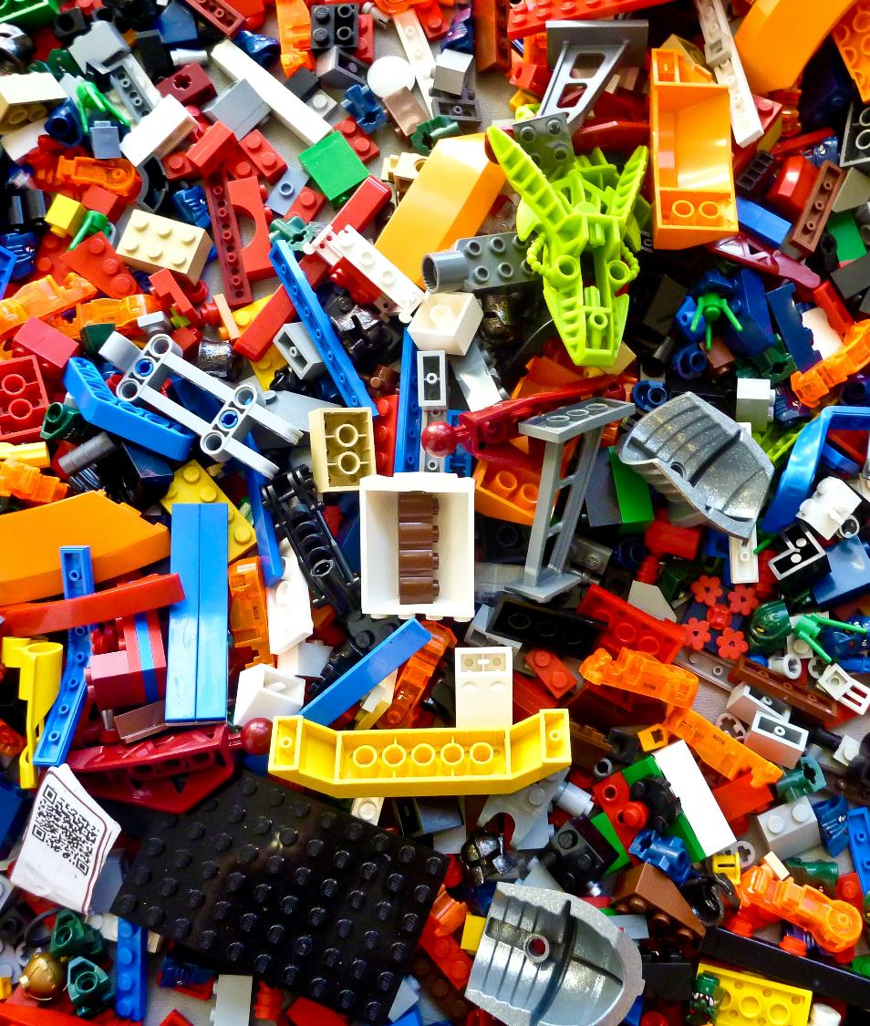
Wrapping Up
Data sets arise from curating or collecting data, resulting from observations, for a purpose.
There are layers between what we want to study and the data we have.
Do the reading!
Photo by Rick Mason on Unsplash

